Slide 1
The Next Generation in Application Insights
Let your application speak volumes!
By ReflectSoftware
Notes:
2min
Thank Lori for inviting us and for everyone showing up.
My name is Callon and this is my colleague Ross and we’re here tonight to talk to you about The Next Generation in Application Insights.
We have a lot to cover, we’ll keep the slides to a minimum and quickly dive into demos which is what you’re going to want to see.
Pause and then hand off to Ross.
Reference
Most companies and development shops neglect the importance of logging and treat it as an afterthought. When applications are in production and issues occur, having meaningful logging and traceability into the state of your application becomes extremely important, especially more so if your company is bound to an SLA and must commit to certain uptime and performance. Having intelligent insight into your application is extremely valuable when analyzing and resolving issues quickly is critical to your company's success.
Traditional simple text base logging frameworks lack what your application can easily emit in providing you better insight into the health of your application. Wouldn’t it be great to easily instrument incredible rich details? Well, look no further. ReflectInsight was designed to easily let your application speak volumes!

Slide 2
What is Application Insight?
Your standard Logging Framework
Configuration
Listeners/Extensibility
Logging
Application Insight Framework:
Structure Data and it’s Extensibility
Rich Details
Traceability
Live Monitoring
Analysis/Filtering/Search…
And Much More!

Slide 3

The Current Status Quo
What most frameworks provide:
The majority of logging is text based and are typically stored in files
The typical message types available are: Debug, Trace, Info, Warn, Error, Fatal and maybe a few more
What is logged is typically unstructured data (i.e. using different text patterns across applications, etc.)
Only minor innovations have occurred in the typical logging framework over the last 10+ years
Notes:
2min
- Before I start this slide, I want to talk about what Application Insights means.
- At a high level application insight is a superset of application logging. It pretty much has the capability of logging and more.

Slide 4

The Inherent Weakness with the Status Quo
So, what is wrong with the current status quo?
Parsing and searching is difficult due to convoluted log files
Data is unstructured
Lack of centralized logging (scattered log files and data chaos)
Lack of traceability
Lack of rich details
Lack of “pro-active” diagnostics and troubleshooting
Lack of trending and application analysis
Lack of real-time monitoring and the health of your application
Lack of tools to help minimize the pain of analyzing, filter and honing in on issues fast and effortlessly
Notes:
3min

Slide 5
The Main Tenets of Application Insights
The framework should have:
Must support structured data and the ability to extend it
Must support traceability on a per request basis
Must be non-intrusive to the application’s performance (low overhead)
Configuration must be flexible and simple to use
Must support the ability to log rich details, going well beyond the limited typical message types
Must have tools to help minimize the pain of analyzing, filter and honing in on issues fast and effortlessly
Must support real-time monitoring
The framework must be extensible
Provide cross-cutting code capabilities via injections (i.e. AOP) (nice to have)
Provide centralized logging and routing capabilities (nice to have)
Provide common logging (nice to have)
Notes:
5min
You will see that some of the logging frameworks support some of these tenets, however to be qualified to support application insights it needs to support them all.
[Closing] Now we believe ReflectInsight fits within the category of Application Insights.

Slide 6
ReflectInsight
The Next Generation in Application Insights
Native support for structured data and it’s extensibility
Real-time troubleshooting of problems as they happen
Rich detailed, user-friendly and intuitive mechanisms for viewing and monitoring applications
Common facility for everyone (NLog, Log4Net, Enterprise Library, etc.)
Ability to view live and historical information
Fully extensible
Simple and flexible to configure
Cross-cutting code capability via injections (i.e. AOP using PostSharp)
Advanced filtering and searching of data
Distributed messaging
It’s enterprise ready
Notes:
5min
We
So what is ReflectInsight and how does it categorize itself as the next generation in application insights?

Slide 7
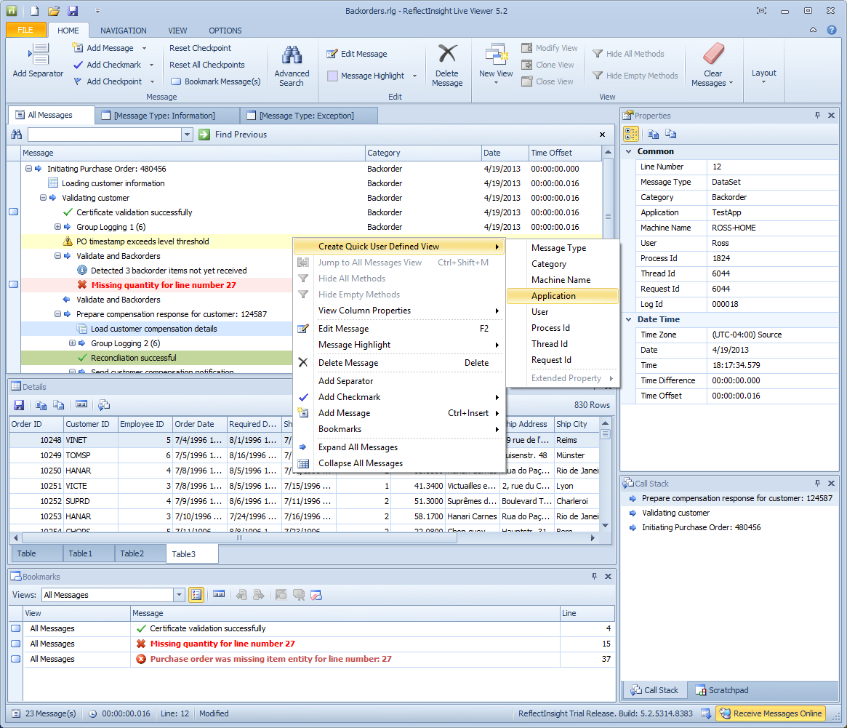
ReflectInsight – Live Messaging and More
Features:
Rich Message Details
Message Properties / Extended Properties
Bookmarking
In-Depth Traceability and Call Stack
Advanced Searching Capabilities
Advanced Message Filtering
Multiple Views Including User Defined
Powerful Message Highlighting
Watches
Real-time and Historical Viewing
Hook into Running Applications
And much more!
Notes:
4min
Have Live Viewer up and running already.

Slide 8
Demo 1
Demonstrate Viewer with Rich Log Details
Notes:
15min
Features to demonstrate
Rich Message Details:
Syntax highlighting like XML, SQL, HTML
Datasets (grids) and remembering of states
Collection/Enumeration
Images
Hex Editor
Colors
Memory
Loaded Assemblies
Threads
Processes
Images
Traceability
- Enter/Exit
Message Properties / Extended Properties
- Inserting/Adding messages/notes/comments/checkmarks (bookmark msg after insert)
Bookmarking
Call Stacks
Scratchpad
Message Navigation
Advanced Search (with regex)
Message Filtering (UDV)
Multiple Views
Columns of view
Saving UDV
Saving with multiple UDV
Shared Views
Time Zones
View Layout
Message Highlighting
Hook into Running Applications
Options
View Properties
Font and Colors
Separators
Auto Save/Purge
Skins
Live Logging

Slide 9
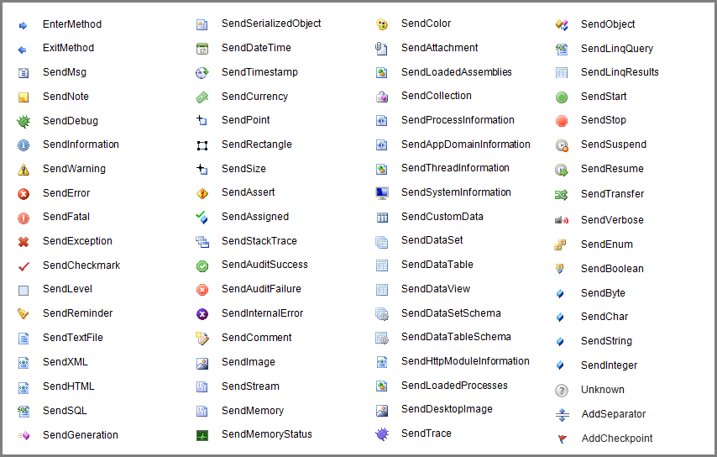
ReflectInsight – Message Types
Notes:
1min
We have just over 60+ messages types. Each have their own set of overloads where necessary.
Our message types go well beyond the typical simple message types found in other frameworks.

Slide 10
ReflectInsight – High Level Architecture
Available Extensions:
Application
Log4net
NLog
Enterprise Logging Application Block
Enterprise Semantic Logging (ETW)
Common.Logging
.NET Diagnostic Debug/Trace
Custom
Extensions
PostSharp
RI API
Listeners
Live Viewer
Binary File
Text File
Console
EventLog
Database
Router
Custom
Other Listeners:
Email
Notes:
4min

Slide 11
Demo 2
Sample using log4net, NLog and EntLib Logging Extensions
Notes:
5min
Make sure to thank Dave for adding XML syntax feature

Slide 12
Demo 3
Live Messaging Native API
Notes:
10min

Slide 13
Demo 4
Sample AOP with PostSharp Extension
Notes:
5min
Make sure PostSharp is installed and configured correctly.

Slide 14
Demo 5
Demonstrate Listeners and Configuration
Notes:
10min
Use the following listeners:
Viewer
Binary File
Text File
Console
Show off configuration for:
Listener Groups
Text Patterns for text file/console
Rolling Log Files
Exception Handlers
Message Filtering (at runtime too)
Enabling/Disabling logging at runtime
Create predefined message filters

Slide 15
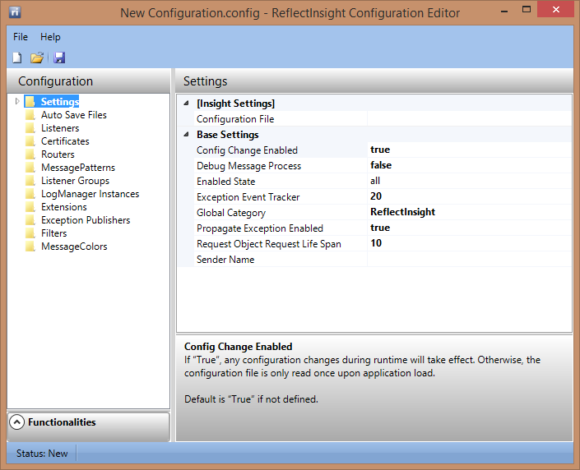
ReflectInsight – Configuration Editor
Features:
User friendly method for configuration
No need to deal with messy XML files
Simplifies configuration
Detailed help panel explaining settings
Notes:
1min

Slide 16
ReflectInsight – Router Service
Machine A
Machine B
Application
Application
Extensions
PostSharp
Extensions
PostSharp
RI API
RI API
Listeners
Listeners
Live Viewer
Binary File
Text File
Console
Live Viewer
Binary File
Text File
Console
EventLog
Database
Router
Custom
EventLog
Database
Router
Custom
Machine C
Router Service:
Readers
TCP/IP
RMQ
MSMQ
Custom
Designed for distributed messaging
Can have one or more simultaneous readers
Chain multiple routers together (re-route)
Can support multiple instances on the same machine
Router Service
RI API
Listeners
Live Viewer
Binary File
Text File
Console
EventLog
Database
Router
Custom
Notes:
3min
Messaging = Log Entry

Slide 17
Live vs Historical Viewing
Differences between Live and Historical Viewers:
Live:
Historical:
Can be used during debugging and/or production
Receive messages in real-time
Hook into running applications
Only one instance is allowed on a given machine session (supports terminal services)
Same capability as Live Viewing without receiving live messages and watches
Can have multiple simultaneous instances
Notes:
2min

Slide 18
Community – NuGet Packages
Available NuGet Packages for ReflectInsight:
ReflectSoftware.Insight
ReflectSoftware.Insight.Extensions.Log4net
ReflectSoftware.Insight.Extensions.NLog
ReflectSoftware.Insight.Extensions.CommonLogging
ReflectSoftware.Insight.Extensions.EnterpriseLibrary
ReflectSoftware.Insight.Extensions.SemanticLogging
ReflectSoftware.Insight.Extensions.DebugTrace
ReflectSoftware.Insight.Extensions.HttpModule
ReflectSoftware.Insight.Extensions.PostSharp
ReflectSoftware.Insight.Listeners.Email
Notes:
2min

Slide 19
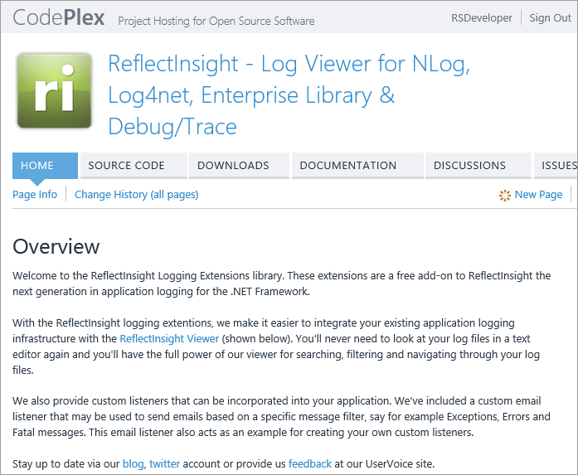
Community – Extensions on CodePlex
Sections:
Documentation
Samples
Open Source
Discussions
Issue Tracking
Notes:
2min

Slide 20






Community – Learn More
Connect and follow us online:
https://www.facebook.com/reflectsoftware
https://twitter.com/reflectsoftware
http://www.linkedin.com/company/reflectsoftware
https://plus.google.com/b/100003697812216387917/100003697812216387917/posts
http://blog.reflectsoftware.com/
Checkout our UserVoice site for knowledge base articles, support and for providing feedback:
http://reflectsoftware.uservoice.com/
Take a look at our logging extensions on CodePlex and get involved if you have an idea for an extension:
https://insightextensions.codeplex.com/
Notes:
2min

Slide 21
How to Contact Us
Ross Pellegrino ross.pellegrino@reflectsoftware.com
Callon Campbell callon.campbell@reflectsoftware.com
Support support@reflectsoftware.com
Info info@reflectsoftware.com
Sales sales@reflectsoftware.com

Slide 22
References
Logging and Auditing http://www.codesecurely.org/Wiki/view.aspx/Security_Code_Reviews/Logging__Auditing
PostSharp http://www.postsharp.net/

Slide 23
ReflectSoftware
Company Information
ReflectSoftware was established in 2009, focusing on creating the standard of live logging tools for the .NET development community, which help our customers better debug, diagnose and monitor the health of applications in any environment.
Trusted by customers worldwide for our devotion and dedication to quality and customer service, ReflectSoftware helps technical and business professionals maximize productivity by allowing them to focus on what matters most to them.
Product quality is an art-form, and like you, we don't believe in compromises. We only release product and services that we can be proud of and use ourselves.
Notes:
1min

Slide 24
ReflectSoftware (continued)
Our Mission
ReflectSoftware’s mission is to produce industry leading, enterprise-class products that empower organizations to produce quality software, while saving time and money. We don’t deviate from our core business and focus, we listen to our customers, and we will only produce the best. If we won’t use it ourselves, we won’t sell it!
Notes:
1min

Slide 25
ReflectInsight The Next Generation in Application Insights
Are you listening to what your application has to say?
Find out more about ReflectInsight and download at http://www.reflectsoftware.com
Notes:
15min
Q&A

